Slide 1

PROJECT PRESENTATION
-GROUP 3

Slide 2

PROJECT PROPOSAL:
FOR any customer or patient WHO requires basic medical requirements such as booking and appointment and getting over the counter medicines, THE Healiam is a web based application service THAT helps to search medicines, booking an appointment with their nearest doctor and to be able to manage their overall medical history effectively. UNLIKE the contemporary applications such as walgreens etc, OUR service has a wide range of uses enabling a customer to manage everything at one place.

Slide 3

Software Vision:
Once a customer logins into Healiam, they will be asked to add in their basic medical information such as their height, weight and any other medical procedures they have undergone. All of this is reflected on their profile and when they book any appointment via the app, the doctors can login from their end and look at all the patients info in advance. Apart from this, customers can order and search commonly used over the counter medicines for cough, cold etc. The app has an analytics chart that showcases the customer reviews, doctor rating and this is updated after every use. With our service we are not only reducing the time to manage customer’s medical history but also reducing the long wait time for appointments. All of this with a touch of a button.
Development Platform: Operating System: Windows, Mac OS Environment: Pycharm,VS Code, React Native Programming Language: Python, Java, JavaScript Database: Firebase, MongoDB Add-on API and frameworks: Google maps API, Firebase Cloud messaging, Firebase authentication UI Design: Adobe XD, Figma

Slide 4

USER STORIES: Implemented
As a customer I would want to add or get a review of the medicine so that other customers can understand it in a better way
There are some function such as DrugReview, postReview which are created for this purpose. Along with their actions to be perfomed.
We have made sure to specify that based on the drug name and the condition that is being added by each user, the filter acts accordingly and parses the information.
Based on which we create a HTML framework, powered by XML parsing and then in the backend we will be using python for the server side interaction.
Python has a wed framework Django which is used in handling HTTP requests.
Also certain API endpoints are created which can be used as action buttons to interact with the SQL server.

Slide 5

As a customer, I would want to be able to check the medicines for a disease so that I would know if there are any side effects for the same
Every customer should be able to lookup their choice of medicine.
For this we are implementing the function in an XML file, for which firstly we build the framework using a HTML file with a search option to input and to parse.
This input is parsed using javascript, here we are using a DOMparser to read through XML data.
In the server-side implementation, we can use XML to search and return the data to the user.

Slide 6
Implemented tasks and spikes:
● As a customer, I would want to be able to check the medicines for a disease so that I would know if there were any side effects for the same.
As a customer I would want to add or get a review of the medicine so that other customers can understand it in a better way ● As a customer, I want to be able to look at a dashboard with a lookup option so that I can search for various diseases and medicines. ● As a customer, I would want to add my medical history and my previous prescriptions. ● Uploading the python files admin and URLs to git ● Dashboard Creation ● Updating the git with views.py, forms.py ● Updated the git with Figma design. ● Updated the git with the model Figma prototype along with screenshots ● Implemented the login page and the action function in python views.py. ● Implemented the customer review button. ● Implemented the backend server-side communication using Django. ● Created the login, patient and drug review form.

Slide 7
Upcoming tasks:
As a user, we want to have customer service support if I face any difficulty in using the application.
As a doctor, I would want to login into the application, so that I can look up my upcoming appointments.
As a customer, I would want to book an Ambulance in the case of an emergency. The above mentioned are the user stories that are to be implemented in the upcoming sprint. We have assigned the tasks respectively and we will be working on them

Slide 8
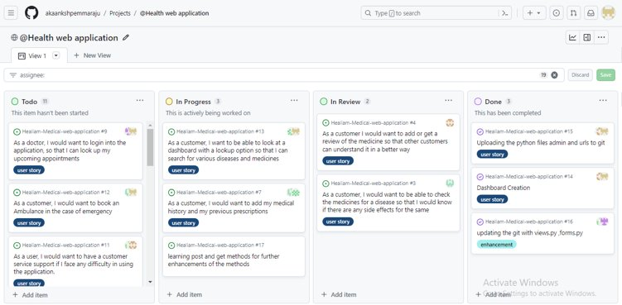

Slide 9


REGISTER
LOGIN
BOOK APPOINTMENT
ADD MEDICAL HISTORY
VIEW APPOINTMENTS
SEARCH MEDICINE
ORDER MEDICINE
BOOK AMBULANCE
WRITE REVEIW
VEIW REVIEW
RESHUDULE APPOINTMENT

Slide 10
AVAILABILITY
DEPLOYMENT FREQUENCY
Change failure rate
Error rate
1 2 3 4 5 6
SPRINT1 SPRINT2

Slide 11
Process measurements:
Lead time: The time it takes to complete a change from start to finish.
Deployment frequency: no of deployments per unit of time. {2 deployments per week}
Change failure rate/Percentage of failed deployments: The percentage of changes that fail to deploy to production.
Mean time to recovery (MTTR): The average time it takes to recover from a production failure. {25 min}
Patient satisfaction with the scheduling process:The level of satisfaction of patient with the overall process of scheduling
Service measurements:
Availability: The percentage of time that the service is available to users.
Performance: The response time and throughput of the service.
Error rate: The percentage of requests that fail.
Patient and doctor satisfaction with the app: The level of satisfaction of users /doctor with the service.
High application uptime: The proportion of time an application remains accessible and operational within a specific monitoring period

Slide 12
Process measurement
Mean time to recovery (MTTR):
Patient satisfaction with the scheduling process
DevOps metrics
Deployment frequency
Lead time
Change failure rate
Patient and doctor satisfaction with the app
High application uptime
Error rate
Availability
Performance
Service measurement

Slide 13
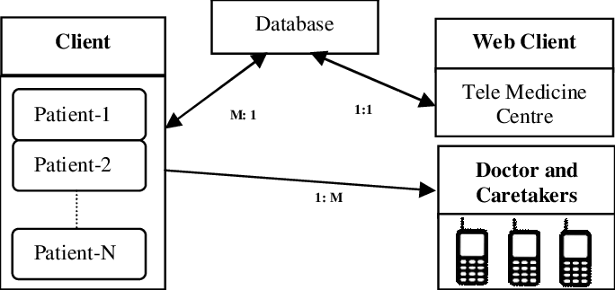
Client – Server Architecture:

Slide 14
API GATEWAY
USER INTERFACE
AUTHENTICATON
Application layer
PAITENT SERVICE
DOCTOR SERVICE
APPPOINTMENT SERVICE
REVIEWS SERVICE
FUNCTIONALITY
DATA ACCESS LAYER

Slide 15

TEAM MEMBERS:
Akaanksh Pemmaraju 11717082 Kusuma Vinay 11706797 Sai Mahesh Nallabirudu 11710226 Sathvik reddy Nandyala 11702270 Ashok reddy Thindi 11690913 Anil Reddy Gokha 11715817 Sriniketh Bhattar 11652290 Sai Sricharan Ayilavarapu 11678775

